Slide 1

UNIVERSAL HUMAN VALUES (UHV38) Unit 2: Understanding Harmony in the Human Being

Slide 2








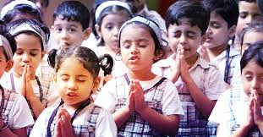

Slide 3


OVERVIEW
Understanding the Human Being as a Co-existence of the sentient ‘I’ and the material ‘Body’
Understanding the needs of Self (‘I’) and ‘Body’ – Sukh and Suvidha
Understanding the Body as an Instrument of ‘I’ (I being the doer, seer and enjoyer)
Understanding the characteristics and activities of ‘I’ and harmony in ‘I’
Understanding the harmony of I with the Body: Sanyam and Swasthya
Programs to ensure Sanyam and Swasthya

Slide 4
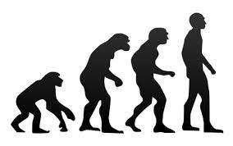

TOPIC 1: UNDERSTANDING THE HUMAN BEING AS A CO-EXISTENCE OF THE SENTIENT ‘I’ AND THE MATERIAL ‘BODY
We are human beings, and we need to first understand ourselves
Human being is a co-existence of two entirely distinct entities, sentient non-material ‘I’ (Self) and the material Body
Their needs and activities are quite different, but they act in close synergy with each other through the flow of information
All the needs of ‘I’ can be called Happiness, while the needs of the body are physical facilities like food, clothing, and shelter
Feelings like respect and trust give happiness

Slide 5
The needs of the body are quantitative. Illustrate
Needs of the body are physical facilities. Physical facilities are needed for body in a limited quantity.
When we try and exceed these limits, it becomes troublesome for us after some time.
If we try and consume, or have too much of physical facilities, it only ends up becoming a problem for us.
When we try to continue infinitely physical facilities, the following pattern results.
(necessary and useful) => (to unnecessary but useful) => (unnecessary and useless) => (intolerable)

Slide 6
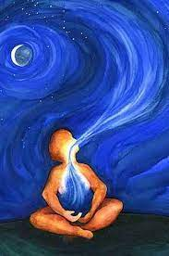
TOPIC 1: UNDERSTANDING THE HUMAN BEING AS A CO-EXISTENCE OF THE SENTIENT ‘I’ AND THE MATERIAL ‘BODY’ (contd….)
Happiness is ensured by having both the right understanding & right feelings, while the physical facility is ensured by appropriate Physico-chemical things
The need for ‘I’ is continuous, while the need for the body is for a limited time, never continuous. Even air is required by the body intermittently
Feeling and its expression are two different things. We want the continuity of any naturally acceptable feeling but not the continuity of its expression.
The needs of ‘I’ are qualitative, while the needs of the body are quantitative & limited Ex: One does not need 5 kg of trust or 2 meters of respect.

Slide 7
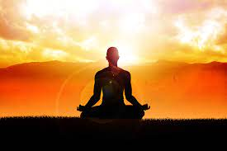
TOPIC 1: UNDERSTANDING THE HUMAN BEING AS A CO-EXISTENCE OF THE SENTIENT ‘I’ AND THE MATERIAL ‘BODY’ (contd….)
The activities of ‘I’ are desiring, thinking, and selecting, while the activities of the body are- eating, breathing, etc.
The mode of interaction of ‘I’ includes knowing, assuming, recognition and fulfillment, while the mode of interaction of the body is only recognizing and fulfilling
Fulfillment depends on recognition; recognition(conduct) depends on assumption and assumption depends on knowing or not knowing (belief)
If assuming is based on knowledge, then recognition will be correct, and fulfillment will be correct
Human being can be understood in terms of a co-existence of two entirely distinct entities, namely sentiment ‘I’ and material body. Their needs and activities are quite different and have to be understood accordingly.
These two constituents of human being are to at in close synergy with each other.

Slide 8
TOPIC 1: UNDERSTANDING THE TWO REALITIES – Needs, Activities, and Response
HUMAN BEING | SELF (I) | BODY
NEED | Happiness (Ex: Respect) | Physical Facility (Ex: Food)
In Time (Need) | Continuous | Temporary
In Quantity (Need) | Qualitative (is Feeling) | Quantitative (Required in limited Quantity)
Fulfilled By (Need) | Right Understanding & Right Feeling | Physio-chemical Things
Activity | Desire, Thought, Expectation | Eating, Walking,…….
In Time (Activity) | Continuous | Temporary
Response | Knowing, Assuming/Accepting, Recognizing, Fulfilling | Recognizing, Fulfilling

Slide 9
TOPIC 1: UNDERSTANDING THE TWO REALITIES – Needs, Activities, and Response

Slide 10



TOPIC 2: Understanding the needs of Self (‘I’) and ‘Body’ – Sukh and Suvidha
Sukh means happiness which is the opposite to Dukh
Suvidha means comfort which is the opposite of Aa – Suvidha
By nature, man is fond off comfort and happiness, so he goes on making desires and ambitions one after the other to enjoy more in life
Sukh depends upon our thinking, so many times we are surrounded by materialistic possessions but feel unsatisfied
People think that their happiness depends upon Suvidha (facilities) but is it not so; our happiness depends upon our thinking or our mental satisfaction
The modern man considers “Suvidha” as the main mission of life, and always try to extract more and more money to satisfy his whim and give happiness to family

Slide 11
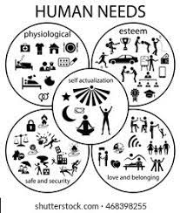
TOPIC 2: Understanding the needs of Self (‘I’) and ‘Body’ – Sukh and Suvidha
Needs of Human Beings:
Physiological Needs: Breathing, Food, Clothing, Shelter, Sound Sleep, Mental Satisfaction
Safety & Security Needs: Personal Security, Financial Security, Health & Well-being, Accidents/illness, and their adverse impacts
Love and belonging: Friendship, Intimacy, Family (Good & Supportive), and Sense of belonging among large social groups (clubs, office culture, religious groups, professional organizations) or small groups (family members, intimate partners, close colleagues)
Esteem: Have self-esteem and self-respect, be accepted and valued by others, engage themselves to gain recognition, a sense of contribution

Slide 12
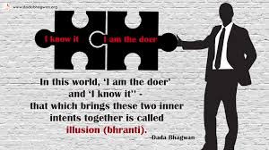
TOPIC 3: Understanding the Body as an Instrument of ‘I’ (I being the doer, seer and enjoyer)
Body and ‘I’ are two separate entities
It is “I” who has to take the decisions for the body. It is “I” who decides to eat and thus, passes the information to the body. Ex: The moment “I” chose to take food, the body shall eat food. The food shall be picked, chewed, and then swallowed by the body
Similarly, “I” decide to take a rest to ensure adequate regaining of energy, then the body shall go to bed and will take rest. This is used as an instrument of “I”
“I Am doer (karta)” :
When we are performing a certain action, we are similarly engaged in the activity of “doing” something Ex: I am dialing the phone to a friend if someone asks me “who is doing this and that?”, the answer shall be “I am doing”. In fact, “I” consciousness is done through the instrument of the body and performs certain functions like picking up the phone, seeing the number, and then dialing. This “I” consciousness is the doer or karta. Anything that I have seen once and understand, then I will be the one to make a decision on what is to be done and What not has to be done

Slide 13
TOPIC 3: Understanding the Body as an Instrument of ‘I’ (I being the doer, seer and enjoyer)
“I Am seer” :
We are involved in the activities of seeing and understanding when reading a book, watching TV, thinking, or when someone is explaining us. When we see something nice like scenery, then we say “I am Seeing” this will means that our self (I) is seeing through our yes. Eyes are just used as Instruments.
“I Am enjoyer”
When I look at the scenery and take pictures. I am the one who sees and does so far. When I see the picture, I like it and enjoy it. Thus, a flow is maintained of being seer, doer and enjoyer. In the same way when I eat, I get taste from the tongue

Slide 14
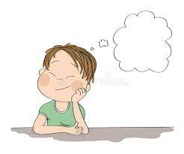
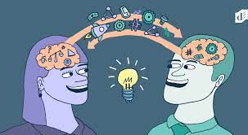

TOPIC 4: UNDERSTANDING THE ACTIVITIES AND CHARACTERISTICS OF ‘I’ AND HARMONY IN ‘I’
If we look at the variety of activities, we are engaged in 3 categories:
Activities that are going on in SELF
Activities that are going on in the BODY
Activities involving both SELF and BODY
Activities that are going on in SELF:
These activities are going on in us all the time and we are usually unaware of them
If we start paying attention to them we can become aware of them, and we can also see that these activities take place irrespective of the state of the body.
Ex: Imagining, Thinking, Understanding, Dreaming, Analyzing

Slide 15
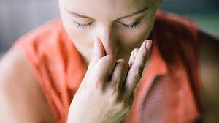

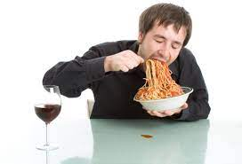
TOPIC 4: UNDERSTANDING THE ACTIVITIES AND CHARACTERISTICS OF ‘I’ AND HARMONY IN ‘I’
Activities that are going on in the BODY:
These activities are going only in the Body but with the consent of “I”
These activities do not require my active participation
Ex: Breathing, Digesting, Blood-flow, Heart-Beat
Activities involving both SELF and BODY:
Activities that are happening with the involvement of both “I” and the “Body”
These activities require my active participation
Ex: Seeing, Talking, Listening, Eating, Walking

Slide 16
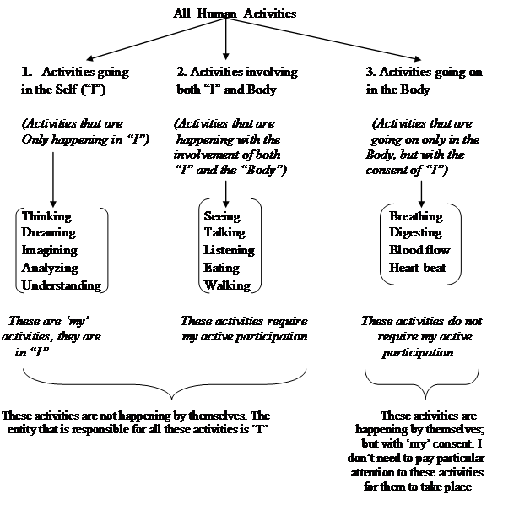
TOPIC 4: UNDERSTANDING THE ACTIVITIES AND CHARACTERISTICS OF ‘I’ AND HARMONY IN ‘I’
Characteristics of SELF:
Creative – we need to always be thinking of new idea
Passionate – passion is essential to any working professional success
Motivated – motivation keeps reminding us the successful path

Slide 17
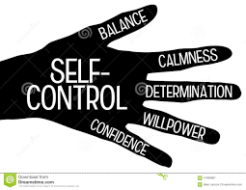

TOPIC 5: UNDERSTANDING THE HARMONY OF “I” WITH THE BODY: SANYAM & SWASTHYA
The harmony of the “I” with the body is in the form of SANYAM, and SWASTHYA on part of the body
SANYAM:
Sanyam means the feeling of responsibility in the self “I” for nurturing protection and right utilization of the body
Self control or SANYAM is the control of the mind and its desires, urges, emotions and delusion (misbelief)
Self control is the key to success in any field of life and it is an indispensable necessity for self-realization, the goal of spiritual quest
Self control constitutes two main aspects: (a) Will power, & (b) Self-discipline which help in the achievement of goals and objectives

Slide 18
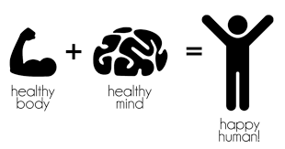
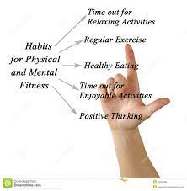
TOPIC 5: UNDERSTANDING THE HARMONY OF “I” WITH THE BODY: SANYAM & SWASTHYA
SWASTHYA:
The body is fit to act according to self “I”. There is harmony among the various parts of the body
What our body follows is only by the permission of “I”
There is a strong coupling between “I” and the body. If I am in disharmony ex: Anger, Stress or despair, then it immediately starts affecting the body adversely
There are many diseases of the body that are caused due to disharmony in “I”. These are called psychosomatic diseases such as Asthma, Migraine etc.
“I” have the feeling of sanyam for the body and the body has swasthya
Sanyam is the basis to Swasthya

Slide 19
TOPIC 6: PROGRAM TO ENSURE SANYAM AND SWASTHYA
SANYAM: “I” take the responsibility of nurturing, protection, and right utilization of the body
Nurturing of the body (posan)
Ingestion (grahan)
Digestion (pachan)
Excretion (nishkasan)
2. Protection of the body (sanraksahan)
Proper upkeep (vihar) of the body
Labour (shram)
Physical exercise (Vvayam)
Asan (pranayama)
Treatment (upchar) of the body
3. Right utilization of the body (sadupyog)
SWASTHYA:
The body is fit according to the self (I)
2. There is harmony among the various parts of the body

Slide 20
What do you mean by Sukh (I) and suvidha (Body)? 1. Sukh is a complete and all surrounding state of the mind that creates inner harmony. Sukh is also called as happiness. 2. Suvidha implies that it is looking for physical comforts and all the sources of attaining such comforts. 3. when our body gets used to a certain level of comfort then we will only feel the comfortable at that level. Eg, Comfort in cooler and air conditioner. 4. Different people have a different perception of suvidha and will seek a corresponding level of suvidha according to their ability. 5. By nature man is fond of comfort and happiness. Sukh depends upon our thinking. So many times we are surrounded by materialistic possession but we feel unsatisfied. 6. People think that their happiness depends upon suvidha (facilities) but is it not so: happiness depends upon our thinking or our mental satisfaction.

Slide 21
Why do human being require both sukh and suvidha ( happiness and facility)? 1. It is clear that physical facilities are necessary and complete for animals, and though they are necessary for human beings, but they are not complete for them. This then marks the difference between human and animal consciousness. 2. Human beings need more than physical facilities because it is the co existence of the Self and the body. Though physical facilities are enough for the Body, we need something more to satisfy the self. 3. Thus, we need two different kinds of things to satisfy both the Body and the Self. 4. In other words, we need both Sukh and Suvidha for a happy and content human being and so one cannot replace the other. For instance, if we only have the trust of people around us but no house to live in, we will not be happy and if we have a big house to live in with all the comforts but no one whom we can trust and love, we will be unhappy. 5. So we need both Sukh and Suvidha to be completely satisfied.

Slide 22
The need of the self are qualitative. Illustrate. 1. Human Beings are a complex combination of the sentiments ‘I’ which relates to all the feeling sand the material ‘body’ which refers to all the physical facilities available to them. 2. Need of self is sukh (happiness). Sukh is qualitative. Therefore the needs of ‘I’ are qualitative. 3. They are not quantifiable. We also want them continuously. We cannot talk of the one kg of the respect or one member of happiness. 4. Our feeling are qualitative. Either they are or they are not. Ex : happiness is qualitative. Either we are feeling happy or we are not. 5. Also if a feeling is not naturally acceptable: we do not want it even for a single moment. If acceptable, we want it continuously. 6. We can see this with example of respect. We don’t want the feeling of disrespect even for a single moment, since it is not naturally acceptable to us

Slide 23
The needs of the body are quantitative. Illustrate. 1. Needs of body are physical facilities. Physical facilities are needed for the body in a limited quantity. 2. When we try and exceed these limits, it becomes troublesome for us after some time. 3. This applies to every physical facility. We only think of having unlimited physical facilities, but if we try and consume, or have too much of physical facilities, it only ends up becoming a problem for us. 4. When we try to continue infinitely physical facilities, the following results.

Slide 24
Explain the relation between the Self and Body. What is the responsibility of self towards the body? 1. The human being is co existence of ‘I’ and the body, and there is exchange of information between the two i.e., ‘I’ and body exist together and are related. 2. There is a flow of information from ‘I’ to the body and from body to the ‘I’. We can make this distinction between the self and the body in three ways in terms of the needs, activities and the types of these two activities. 3. All the needs of ‘I’ say respect, trust etc., can be called as Happiness, while the needs of body are physical facilities like food. 4. The activities of ‘I’ are activities like, desire, thinking, selection, while the activities of body are activities like eating, breathing etc. 5. The mode of interaction of ‘I’ includes knowing, assuming, recognising and fulfilment. The fulfilment depends on recognition depends on assumptions and assumptions depends on knowing or not knowing.

Slide 25
Differentiate between the needs of self and ‘I’. The human being is the co-existence of ‘I’ and the body, and there is exchange of information between the two. We can make this distinction between the self and the body in terms if the needs as shown in the table below:
Needs are : The need for the body like food for nourishment clothes for protection and instruments are physical facilities.
whereas the need of ‘I’ is to live in the state of continuous happiness. The need of the body are physical in nature, whereas the needs of the ‘I’ are not physical in nature – like trust , happiness, respect etc.

Slide 26
2. In Time, Needs are : The need if ‘I’ are continuous in time, unlike the need of the body, which is temporary in time. we want happiness continuously. If we talk about food, clothing, shelter or instruments, these are needed only for some amount of time. So need for physical facilities of the body is temporary in time- it is not continuous. 3. In quality, needs are: The physical facilities needed for the body in the limited quantity. When we try and exceed these limits, it becomes troublesome for us after some time. Whereas the needs of ‘I’ are qualitative but we also want them continuously. Ex: Happiness is qualitative. Either we are feeling or they are not. 4. Needs are fulfilled by: The need of the self ‘I’, for happiness is ensured by right understanding and right feeling, while the need of the body, for physical facilities, is ensured by appropriate physico-chemical things.

Slide 27
Explain the body as instrument of ‘I’.
1.There is a big difference between the Body and the Self.
2. The self is a conscious entity and knows that it exists.
3. The Body is an material entity and only does what the Self instructs it to do.
4. The self thinks, takes the decisions and then instructs the Body to act accordingly.
5. For instance, when the Self decides that it is time to study, then the body sits in a chair, opens up the books and starts reading.
6. The self absorbs whatever the eyes read, analyses that information and understands it.
7. The Body doesn't sit in the chair and open the book without the bidding by the Self and the eyes alone do not understand whatever they read
8. The Self instructs the Body to sit and open the book and the Self understands the information being read by the eyes.
9. Thus, the Body is a tool or an instrument of the Self.

Slide 28
Conflicts and contradictions in ‘I’ as a Result of Preconditioned desire
The desires, thoughts and selections are in conflicts. Since the desires are in conflicts, the thoughts they give rise to, are also in conflict and in turn, the selection from the thoughts are also in conflicts.
This conflict affects us in different manners:
Wavering aspirations: Our goals keep shifting as the inputs from the outside also keep changing.
b. Lack of confidence : Since our desires are shaky, we are not sure about them.
c. Unhappiness/conflicts: Since out desires, thoughts and expectations are in conflict, it becomes the cause for our unhappiness, leading to stress and tension.
d. Lack of qualitative improvement in us: we focus largely on fulfilling the needs of the body. As a result, we live with a sense of lack of fulfilment.
e. State of resignation: Because we do not understand the ourselves properly and have contradictions within, we slowly start getting disillusioned.

Slide 29
Elaborate how sensation from the body cannot be a source for continuous happiness. 1. Pleasure from sensation is short lived because it only caters to our bodily needs, which are temporary by nature. 2. For Ex. If we like to eat chocolates, we might eat them regularly. 3. Soon, we might start eating them every day because our happiness depends on satisfying out desires to eat chocolates. 4. And if one day, we are not able to eat chocolates, we start feeling unhappy and very upset. 5. This shows that a desire that depends on bodily needs will definitely make us unhappy after a stage. 6. Similarly, when we are driven by any of the 5 senses of our body including, sight, smell, taste, touch and hearing, we become slaves of the these senses. 7. The needs of all the 5 sense are temporary by nature, whereas the needs of the Self are continuous. 8. To test the need of the Self, we only need to ask ourselves whether we want happiness continuously or not. 9. The most obvious answer is we want happiness continuously. 10. Thus, any kind of pleasure from a sensation from the body cant be the source of our lasting happiness.

Slide 30
How harmony in individual is possible? 1. Harmony in the self is something that leaves to harmony at all levels of being. This understanding is essential for each of us to leave a life fulfilment and continuous happiness, the four step process that leads to harmony in the self is : i. Becoming aware that a human is the coexistence of self/ I and the body. ii. Becoming aware that the body is only an instrument of self or I. I is the seer, doer, and enjoyer not the body. iii. Becoming aware of the activities of the self desires, thoughts and expectations and then put these desires, thoughts and expectations through the test of your own natural acceptance iv. Understand the harmony at all levels of existence leading to realisation and understanding which inturn leads to a sense of definiteness in our desires, thoughts and expectations. 2. This attainment of harmony leads to a clear flow with no contradictions or conflicts. So we have a better understanding of ourselves, our basic aspirations and the way in which we can fulfil these aspirations. 3. Thus, we have a better understanding of all things around us and our relationship with all those around us. This leads to a state of being svatantrata and we become self organised in our imagination, behaviour and work resulting in continuous happiness and prosperity.

Slide 31
Explain the activities of realisation and understanding. How do they lead to harmony in the activities of I? Illustrate with an example. Realisation: Realisation means to be able to see the reality as it is. In realisation, we get the answers to “what is reality?” this, for each one offers translate into the answers to “what to do?” and “why to do?” when the operate on the basis of realisation and gains understanding according to the realisation then it give definiteness and certainty and make us self organised. Understanding: 1. Understanding means to be able to understand the self organisation in all entities of nature and their interconnected organisation “as it is”. We are able to see the harmonious interact interconnectedness at all the levels of our living. 2.Understanding place and important role in desire making. 3. When we do not have the right understanding, our desire keep shifting, and this indefiniteness is reflected in our thoughts, and selections we make, and finally in our behaviour and work. 4. On the other hand, when our understanding is based on the realisation and the use this understanding in desire making then our desire will be correct and thoughts and selections will be according to the understanding.

Slide 32
Why do sensation and preconditioning leads to our bondage? Point out the best method to regain our freedom. 1. The solution to this problem is to start verify our desires, thoughts and expectations on the basis of our natural acceptance. 2.Since the natural acceptance of each of us is constant and unchanging, this is what we should be verifying our desires against. 3. Once we access our natural acceptance we have the right understanding of the harmony at all levels of our living. 4. This result is us being able to see our “true nature” and understand what we truly want 5. So our desires start getting set on the basis of our right understanding. 6. Since a right understanding is based on harmony at all levels of being, which is definite, our thoughts, desire and selection becomes aligned with this right understanding. 7. This puts an end to all conflicts, contradictions and happiness. 8. Realisation and understanding are too very important aspects of this state of harmony. 9. Understanding means to be able to see the way all levels of our being are linked together in a harmonious manner. 10. The progress then this is: with realisation and understanding, our desires or imagination gets set according to the right understanding. 11. Thus, living with definiteness is the direct result of realisation and understanding.

Slide 33
Define sanyam( Self Control) and Swasthya(Heath). explain various responsibility of ‘I’ for the body in brief. 1. Sanyama means the feeling of responsibility in the self for nurturing, protection and right utilisation of the body. 2. Self control is the control of the mind and its desires, urges, emotions and delusions. It is controlling the outgoing tendencies of the mind and the senses and bringing the back to our self within. 3. Swasthya is the condition of the body where every part of the body is performing its expected function. The word swasthya literally means being anchored to the self, being in close harmony with the self. 4. With the right understanding and right feeling the body get favourably affected.

Slide 34
Suggest any two programs that you can undertake to improve the health of your body. Or How does the feeling of sanyam ensure health of the body ? List two programs of sanyam? Nursuring of the body Proper food air water: In this process of selecting food for the body, I need to make out the elements which make a complete food so that it gives required nutrients and energy to the body Protection of the body The second issue is the protection of the body. The clothes we choose for protection to be such that the ensure proper interaction of the body with the environment. Proper upkeen (vihar) of the body When we work, the body gets tired. when we take rest the body becomes fit to work. But again there is a limit to the amount of work and the rest we need. Labour It is another requirement, it means employing the body physically for production and maintenance of the physical facilities. These labour we do help each part of the body to function properly.

Slide 35
Physical exercises With exercises we can employee all the parts of the body in the desired way. Asanas/ Pranayam This is another way to keep the body function properly. In asanas, We give the body proper posters by sitting or lying. In pranayamas be ensure regulation of the breathing. Treatment of the body With all the care we take, the body may require treatment at times. It may be that just by going without food for some time the body get cured. Right choice for food may also help. The treatment of the body can be done by proper exposure of the body to the sun, to air and to water. Use of herbs or medicines may also serve the purpose. Right utilization of the body (sadupyog) Body as an instrument of necessitates understanding the purpose for which this instrument is to be used. Normally we tend to believe that the body is an instrument for sensory enjoyment, which is not correct. It is important to realize that the human body is an instrument to facilitate right understanding and actualization in life.

Slide 36
Important Questions: 1. "Human being is more than just the Body"- explain. 2. Distinguish between the needs of the Self and the needs of the Body. 3. What is the qualitative difference between the activities of the Self and those of the Body? Illustrate withone example. 4. What are the consequences of confusing between Sukh and Suvidha? 5. 'I' is a conscious unit while the Body is a material unit. Examine this statement. 6. Why are physical facilities required? What do you mean by right utilization of the Body? 7. "I am the seer, doer and enjoyer. The body is my instrument"- explain. 8. What is Pre conditioning and its sources? 9. “I am seer, doer, and enjoyer. The body is my instrument”. Explain. 10. Suggest programs to ensure proper functioning of your body. Can we sustain them without right understanding?

Slide 37
THE END……

